Slide 1
Chapter 7
Confidence Intervals and Sample Size
Understanding Confidence Intervals: Statistics Help

Slide 2
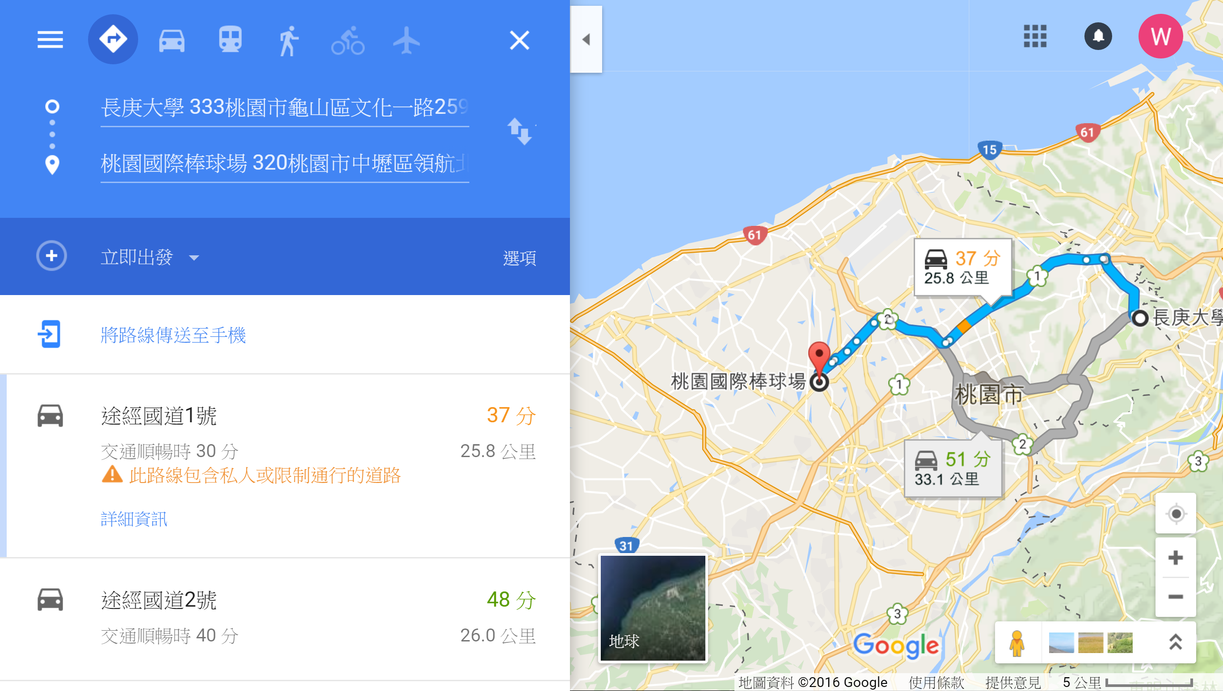

Slide 3
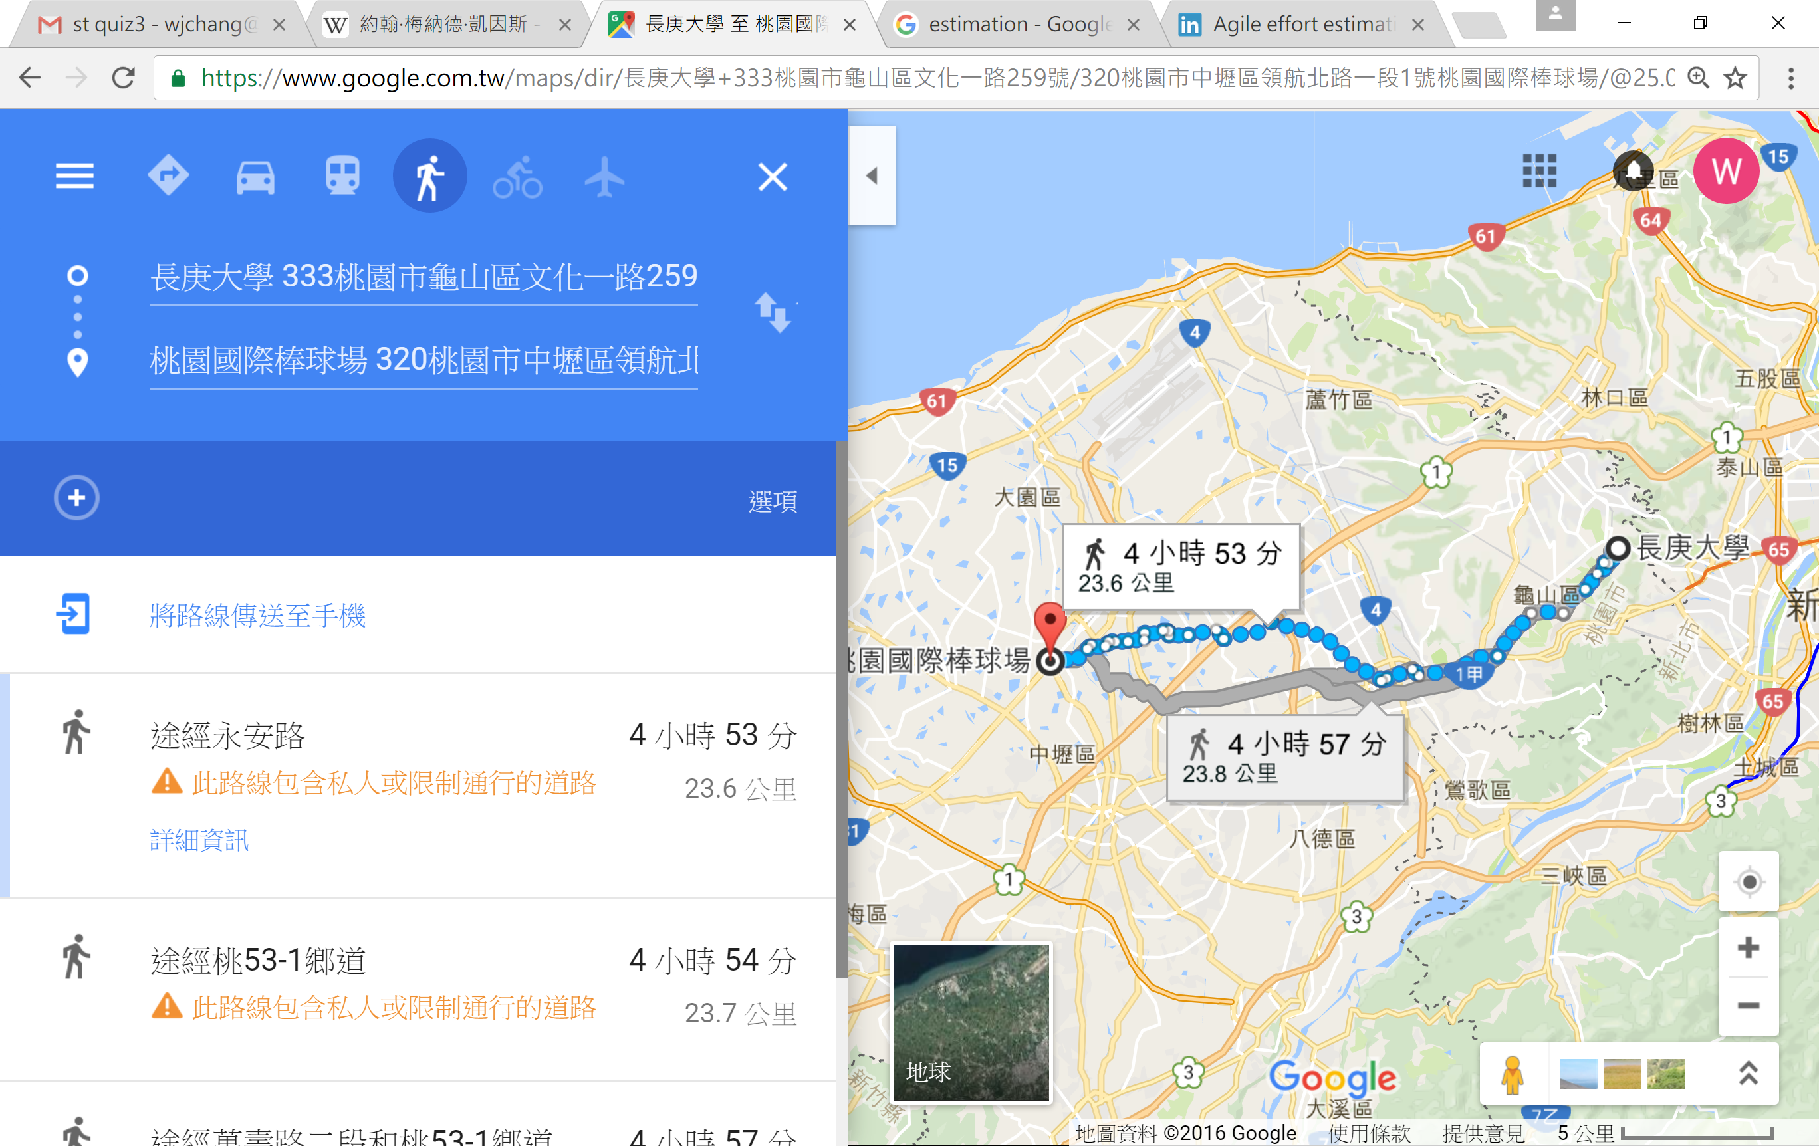

Slide 4



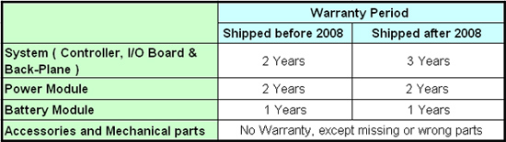


Slide 5
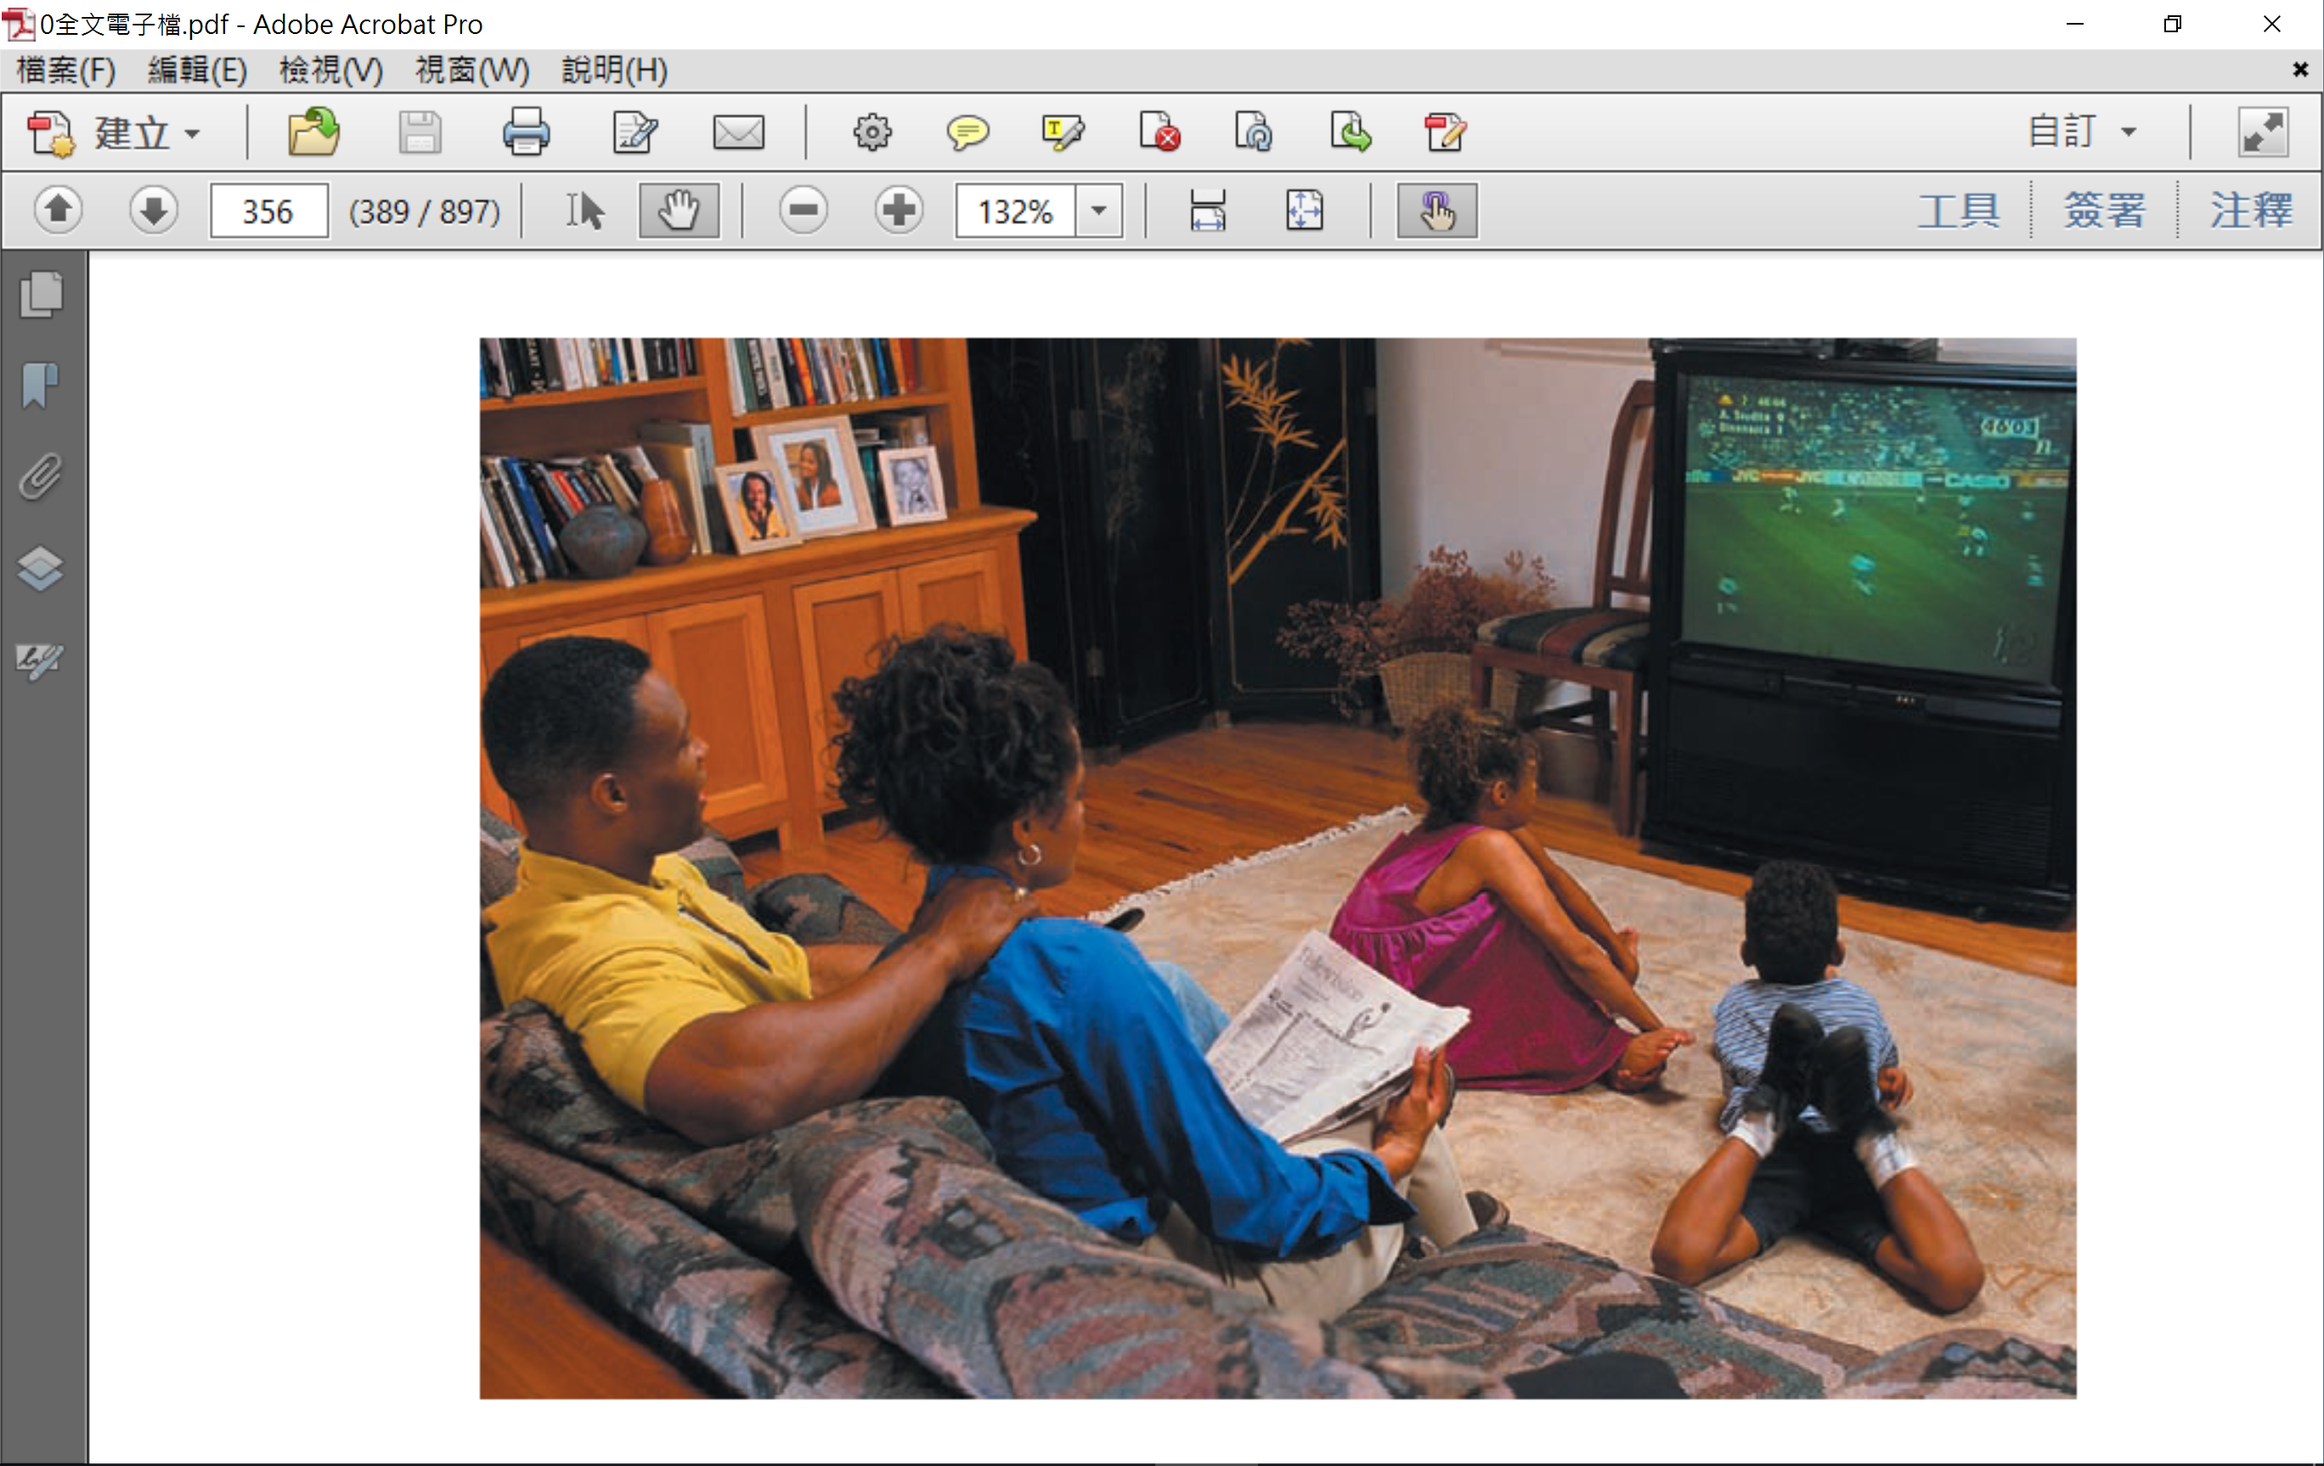
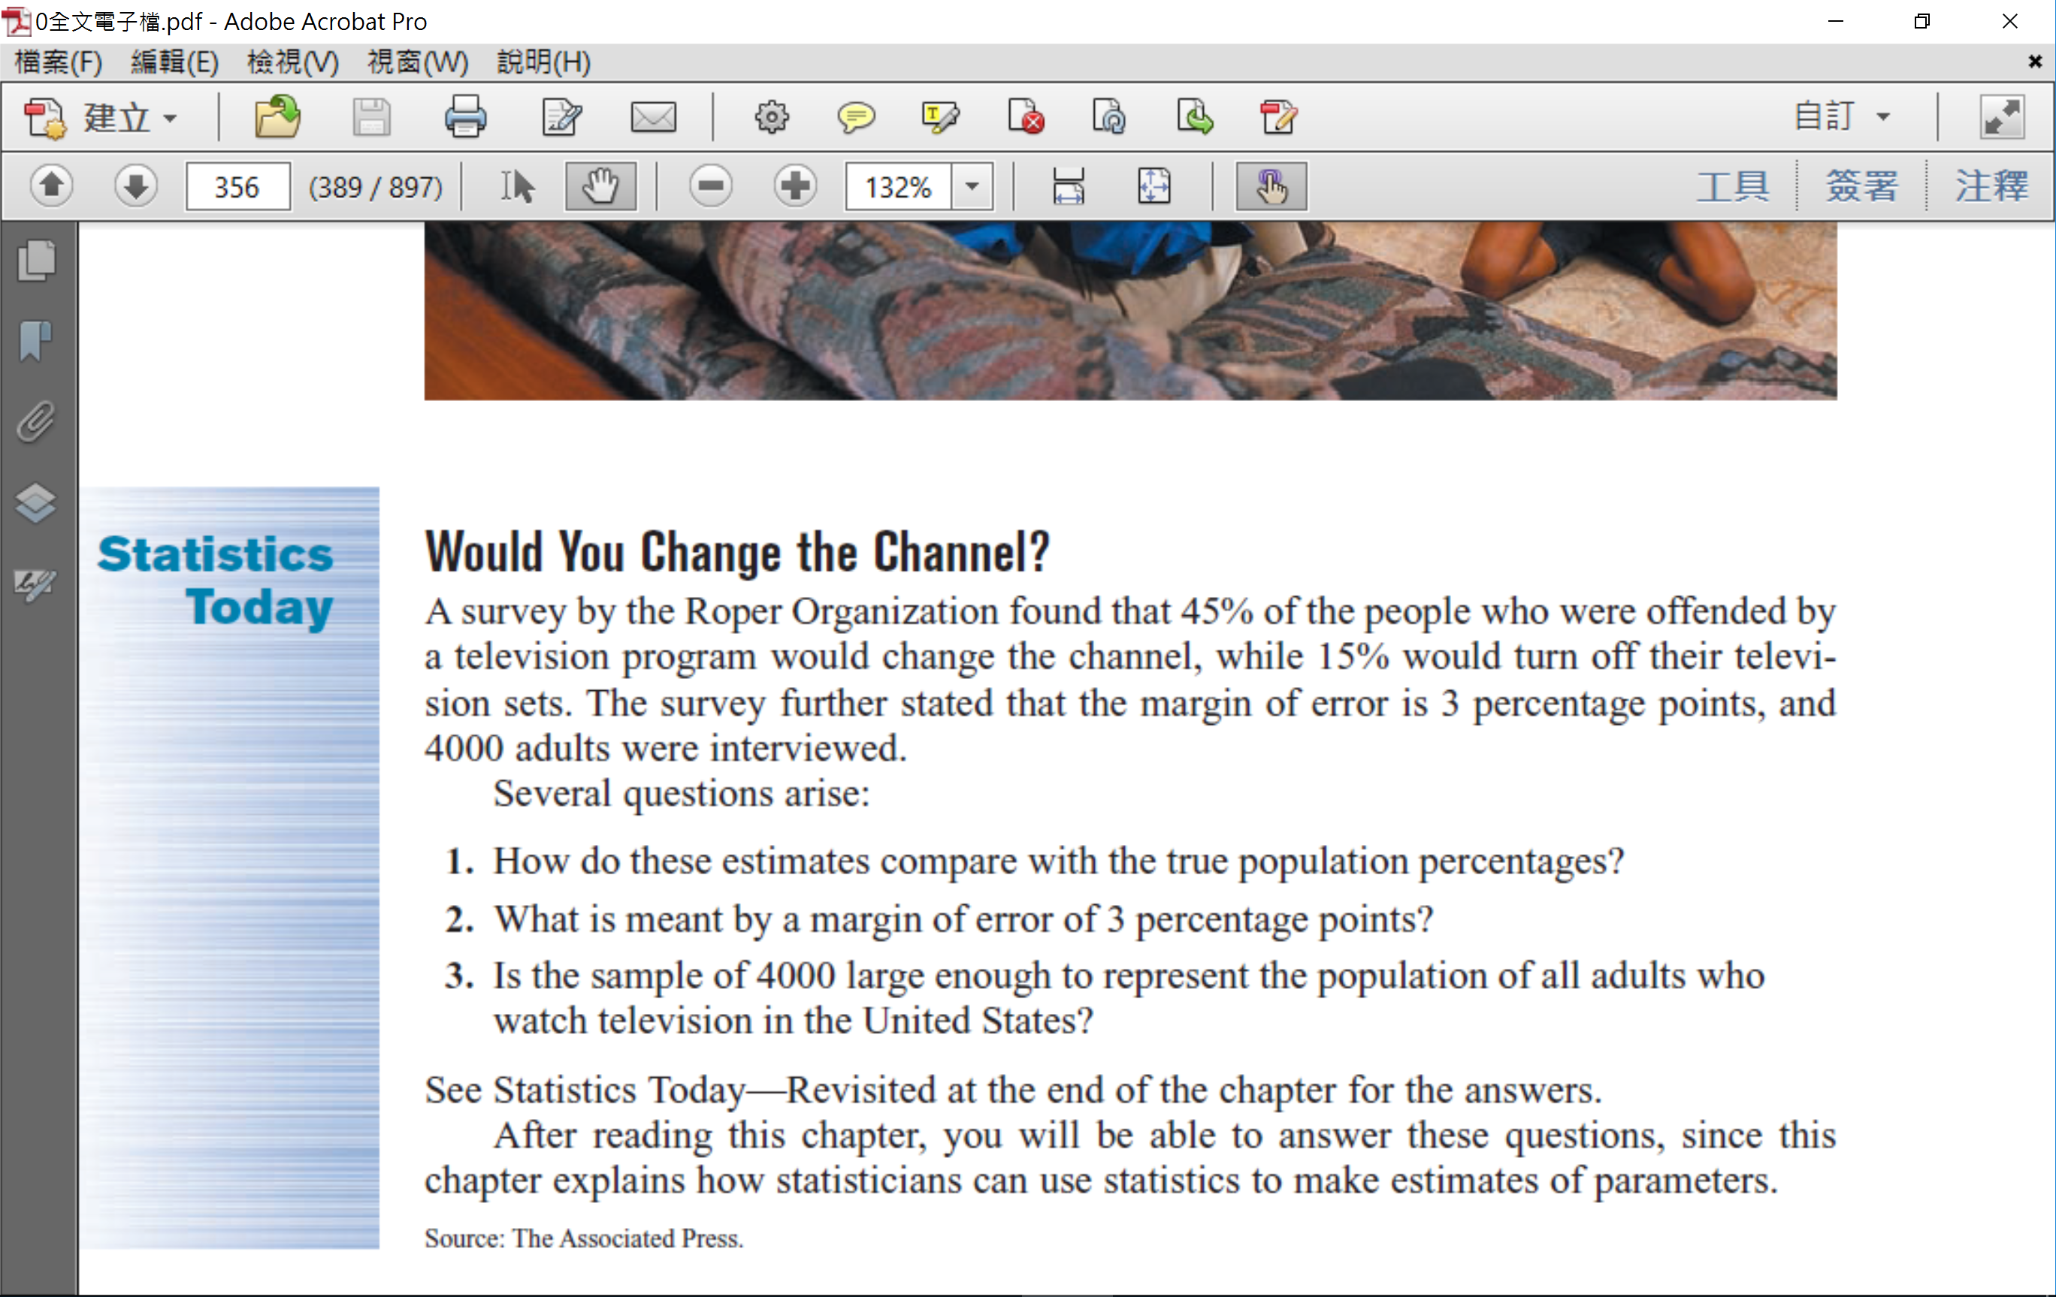

Slide 6
Confidence Intervals for One Population Mean
單一母體平均數之區間估計
前 言
母體平均數之 區間估計
--大樣本
母體平均數之 區間估計
--小樣本
樣本數
的選擇
點估計的意義與概念
母體變異數
已知
母體常態
變異數已知
估計母體平均數時，樣本數的選擇
區間估計的意義與概念
母體變異數
未知
母體常態
變異數未知

Slide 7
Outline
Introduction
7-1 Confidence Intervals for the Mean
(When σ Is Known and Sample Size)
7-2 Confidence Intervals for the Mean
(When σ Is Unknown)

Slide 8
Objectives
Find the confidence interval for the mean when σ is known.
Determine the minimum sample size for finding a confidence interval for the mean.
Find the confidence interval for the mean when σ is unknown.

Slide 9
Introduction
Estimate
The value(s) assigned to a population parameter based on the value of a sample statistic is called an estimate.
Estimator
The sample statistic used to estimate a population parameter is called an estimator.
Source: P.S. Mann, Introductory Statistics, 5th ed. John Wiley, 2005

Slide 10
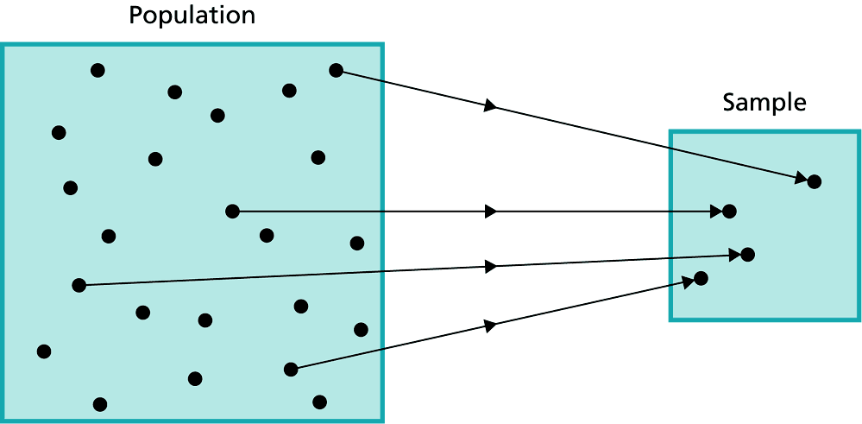
Estimation Procedure
Parameter Statistic
μ
Select a sample.
Collect the required information from the members of the sample.
Calculate the value of the sample statistic.
Assign value(s) to the corresponding population parameter.
Source: P.S. Mann, Introductory Statistics, 5th ed. John Wiley, 2005

Slide 11
Estimation Methods
A Point Estimate
The value of a sample statistic that is used to estimate a population parameter is called a point estimate.
An Interval Estimate
In interval estimation, an interval is constructed around the point estimate, and it is stated that this interval is likely to contain the corresponding population parameter.

Slide 12

“It’s better to be roughly right than precisely wrong”
~John Maynard Keynes~

Slide 13
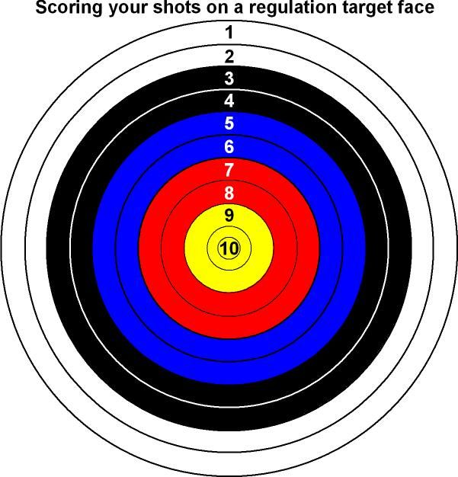


Slide 14
Section 7-1
Confidence Intervals for the Mean
When σ Is Known and Sample Size

Slide 15

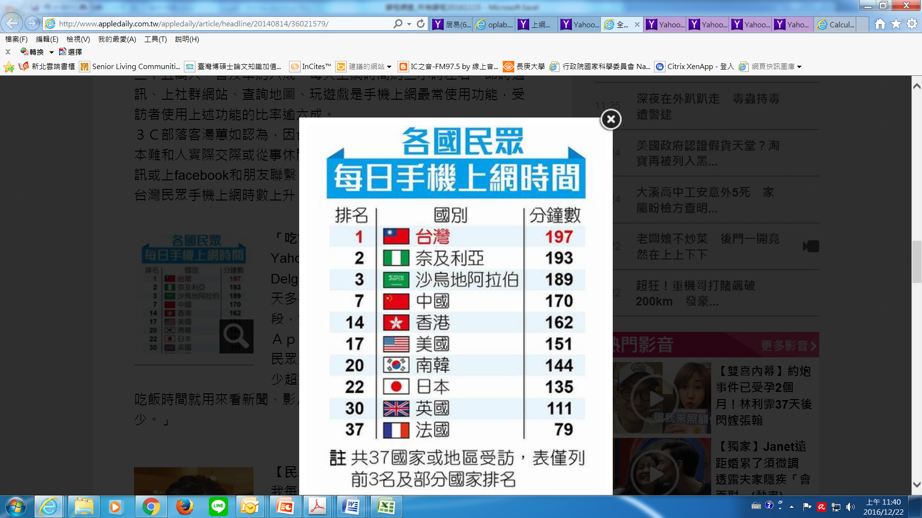

Slide 16
Point Estimate
A point estimate of a parameter is a specific numerical value, statistics, used to estimate the parameter.
The best point estimate of the population mean µ is the sample mean
Parameter Statistic
μ

Slide 17
Three Properties of a Good Estimator
1. Unbiase
The expected value or the mean of the estimates obtained from samples of a given size is equal to the parameter being estimated.
2. Consistent
For a consistent estimator, as sample size increases, the value of the estimator approaches the value of the parameter estimated.
3. Relatively efficient (smallest Variance)
The estimator should be a relatively efficient estimator; that is, of all the statistics that can be used to estimate a parameter, the relatively efficient estimator has the smallest variance.

Slide 18
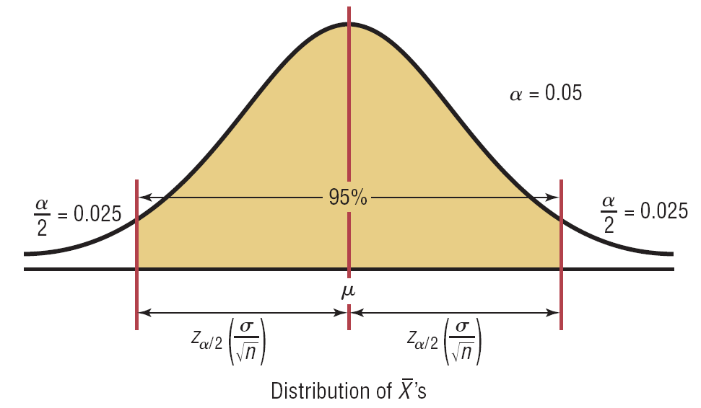
Confidence Intervals for the Mean When σ Is Known and Sample Size
An interval estimate of a parameter is an interval or a range of values used to estimate the parameter.
This estimate may or may not contain the value of the parameter being estimated.

Slide 19
區間估計的概念
信賴水準(confidence level)
信賴係數(confidence coefficient)
信賴區間(confidence interval)
信賴下限(lower limit of confidence)
信賴上限(upper limit of confidence)

Slide 20
Confidence Level
The confidence level of an interval estimate of a parameter is the probability that the interval estimate will contain the parameter, assuming that a large number of samples are selected and that the estimation process on the same parameter is repeated.

Slide 21
Confidence Interval
A confidence interval is a specific interval estimate of a parameter determined by using data obtained from a sample and by using the specific confidence level of the estimate.

Slide 22
母體平均數的估計
單一母體平均數μ的估計
樣本平均數 之抽樣分配(或近似)為常態分配
樣本平均數 之抽樣分配為 t 分配
兩個母體平均數差 μ ₁ −μ ₂ 的估計
兩組獨立樣本的區間估計
兩組相依樣本的區間估計

Slide 23
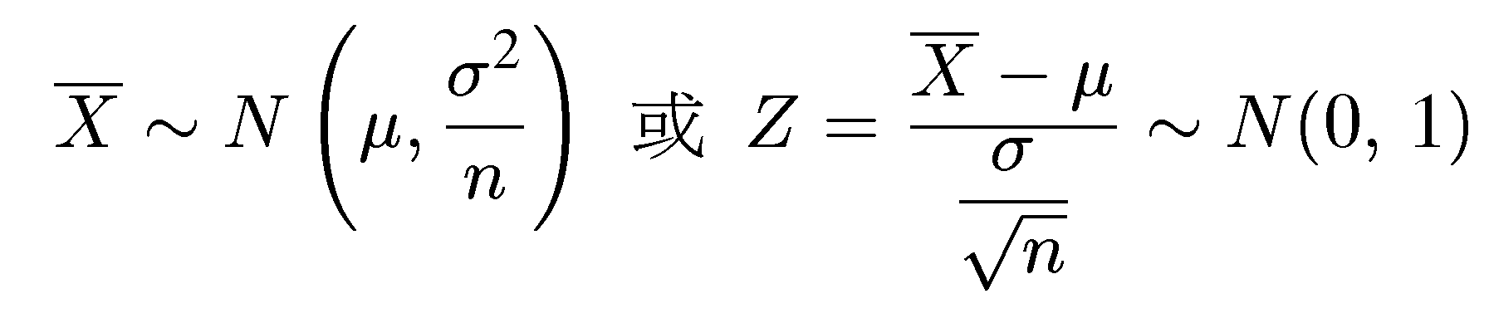
母體平均數的估計
單一母體平均數 μ 的估計
樣本平均數 之抽樣分配為常態分配
當母體為常態分配時，樣本平均數 的抽樣分配亦為常態分配，即 或 。
當母體不為常態分配時，但在大樣本情況下，根據中央極限定理可得知樣本平均數 的抽樣分配近似常態分配，即

Slide 24
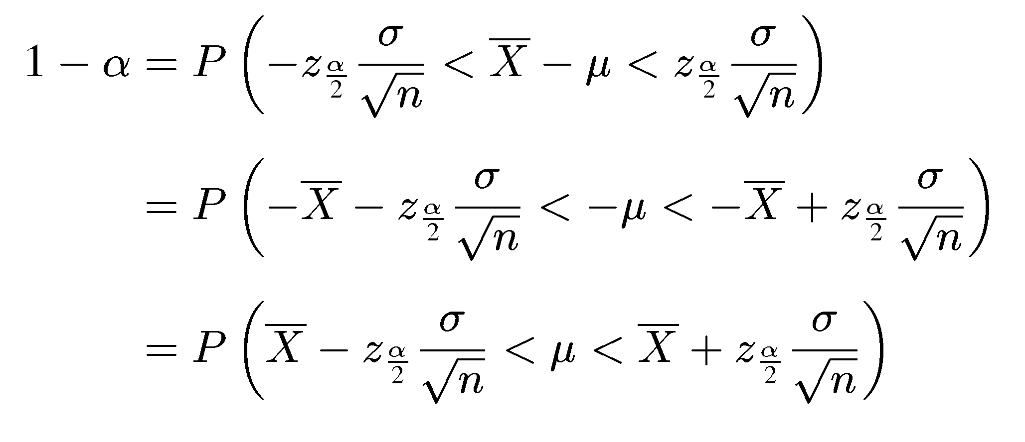
母體平均數的估計
若樣本平均數之分配為常態時，則
➔母體平均數會落在區間 之機率為1−α %
此即為 µ的(100−α )%信賴區間

Slide 25
母體平均數的估計
為了進一步了解信賴區間的意義，我們模擬自常態母體，µ = 100 與 σ = 4，取出一組樣本數為 4 之隨機樣本，計算其母體平均數的 95% 信賴區間。重複進行試驗 25 次後，其結果如下：

Slide 26
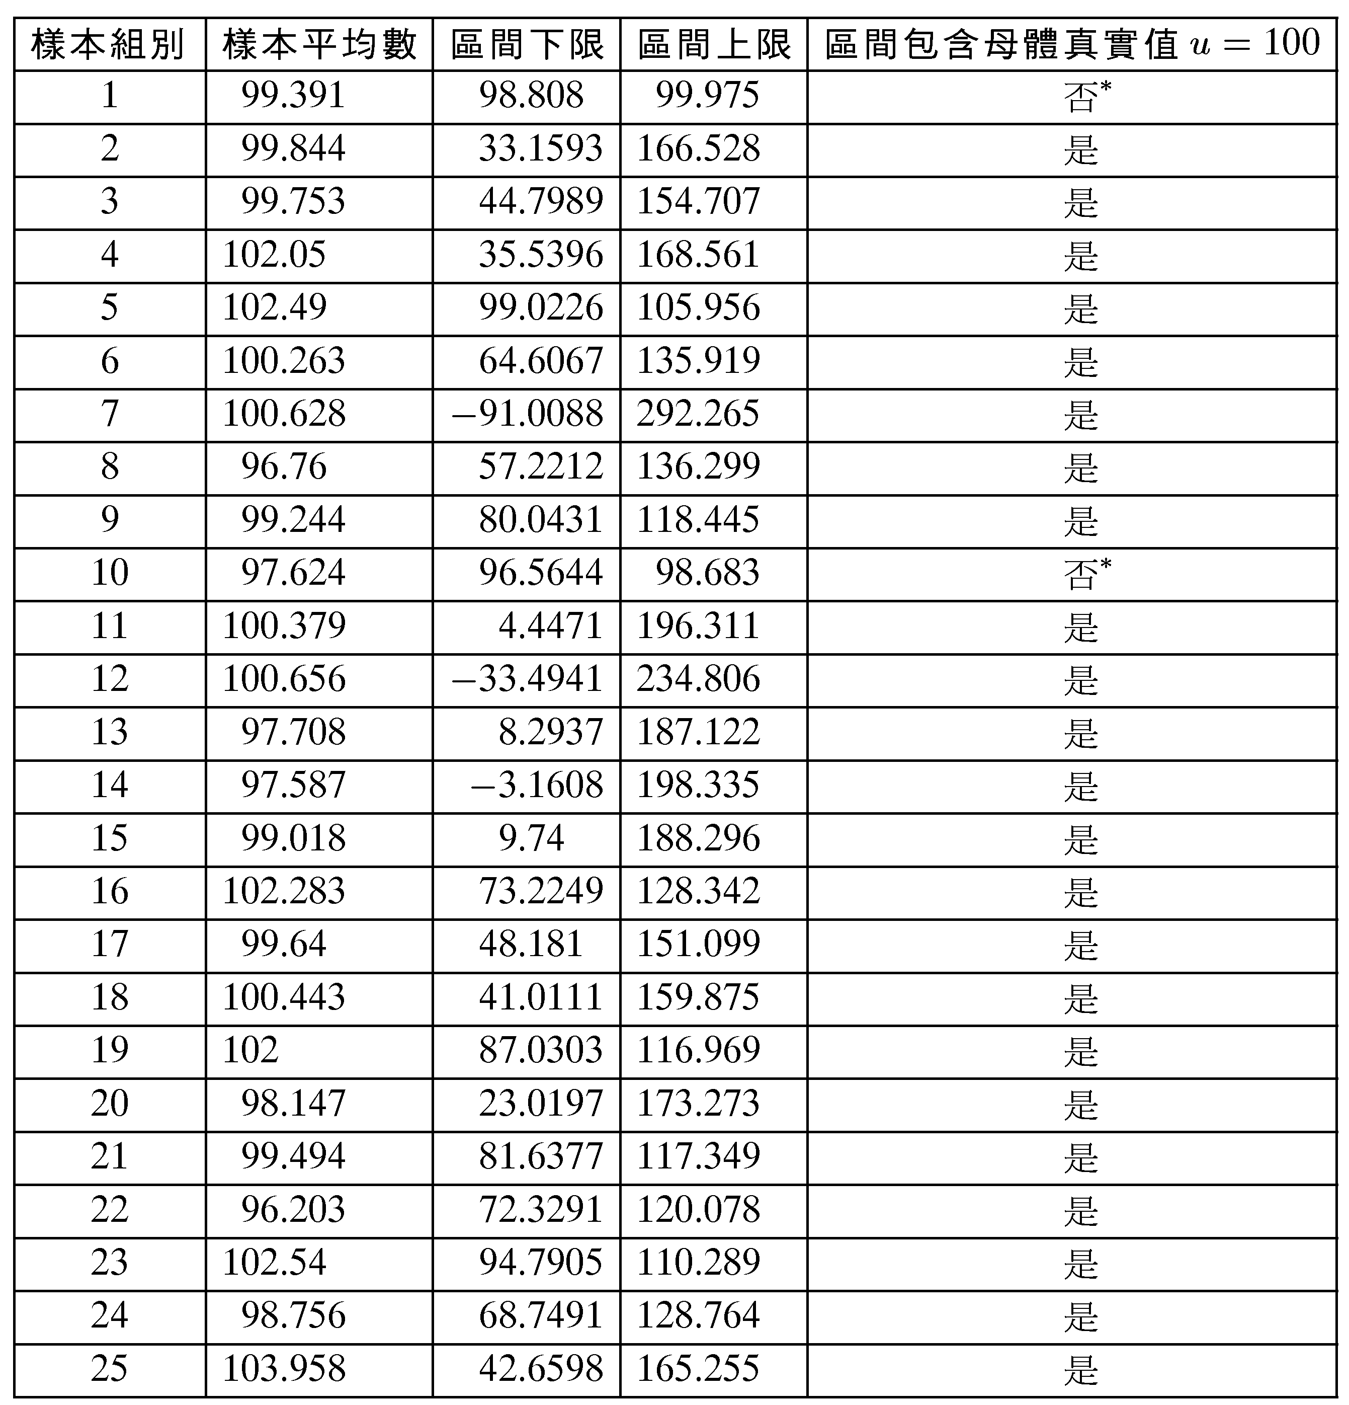
表 6-1 估計母體平均數 μ 之 95% 信賴區間

Slide 27
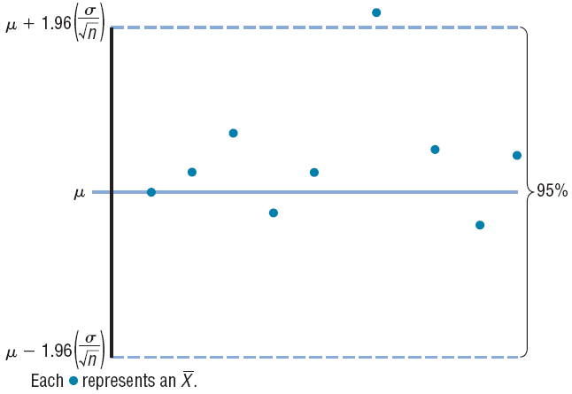
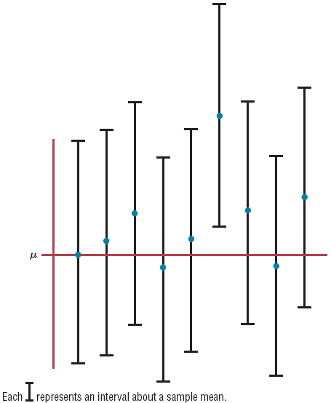
95% Confidence Interval of the Mean

Slide 28
95% Confidence Interval of the Mean
One can be 95% confident that an interval built around a specific sample mean would contain the population mean.

Slide 29
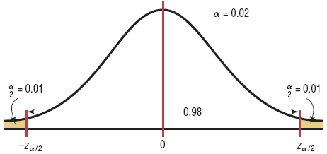
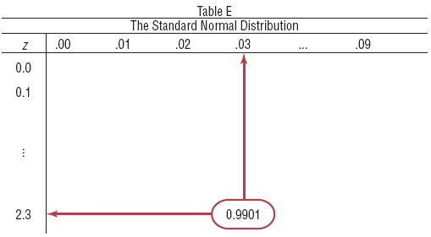
Finding for 98% CL.

Slide 30
Formula for the Confidence Interval of the Mean for a Specific α
For a 90% confidence interval:
For a 95% confidence interval:
For a 99% confidence interval:

Slide 31
Example: Credit Union Assets
The following data represent a sample of the assets (in millions of dollars) of 30 credit unions in southwestern Pennsylvania. Find the 90% confidence interval of the mean.
12.23 16.56 4.39
2.89 1.24 2.17
13.19 9.16 1.42
73.25 1.91 14.64
11.59 6.69 1.06
8.74 3.17 18.13
7.92 4.78 16.85
40.22 2.42 21.58
5.01 1.47 12.24
2.27 12.77 2.76

Slide 32
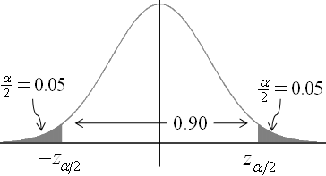
Example: Credit Union Assets
Step 1: Find the mean and standard deviation.
➔ = 11.091 and s = 14.405.
Step 2: Find α/2. 90% CL → α/2 = 0.05.
Step 3: Find z_{α/2}. 90% CL → α/2 = 0.05 → z_{.05} = 1.645
Table E
The Standard Normal Distribution
z | .00 | … | .04 | .05 | … | .09
0.0 0.1 . . . 1.6 |  |  | 0.9495 | 0.9505

Slide 33
Example: Credit Union Assets
Step 4: Substitute in the formula.
One can be 90% confident that the population mean of the assets of all credit unions is between $6.752 million and $15.430 million, based on a sample of 30 credit unions.

Slide 34

Example 7-1: Days to Sell an Aveo
A researcher wishes to estimate the number of days it takes an automobile dealer to sell a Chevrolet Aveo. A sample of 50 cars had a mean time on the dealer’s lot of 54 days. Assume the population standard deviation to be 6.0 days. Find the best point estimate of the population mean and the 95% confidence interval of the population mean.
The best point estimate of the mean is 54 days.

Slide 35
Example 7-1: Days to Sell an Aveo
One can say with 95% confidence that the interval between 52 and 56 days contains the population mean, based on a sample of 50 automobiles.

Slide 36
Example: Ages of Automobiles
A survey of 50 adults found that the mean age of a person’s primary vehicle is 5.6 years. Assuming the standard deviation of the population is 0.8 year, find the best point estimate of the population mean and the 99% confidence interval of the population mean.
The best point estimate of the mean is 5.6 years.
One can be 99% confident that the mean age of all primary vehicles is between 5.2 and 6.0 years, based on a sample of 30 vehicles.

Slide 37
Example 7-3: Credit Union Assets
The following data represent a sample of the assets (in millions of dollars) of 30 credit unions in southwestern Pennsylvania. Find the 90% confidence interval of the mean.
12.23 16.56 4.39
2.89 1.24 2.17
13.19 9.16 1.42
73.25 1.91 14.64
11.59 6.69 1.06
8.74 3.17 18.13
7.92 4.78 16.85
40.22 2.42 21.58
5.01 1.47 12.24
2.27 12.77 2.76

Slide 38
Example 7-3: Credit Union Assets
Step 1: Find the mean and standard deviation.
➔ = 11.091 and s = 14.405.
Step 2: Find α/2. 90% CL → α/2 = 0.05.
Step 3: Find z_{α/2}. 90% CL → α/2 = 0.05 → z_{.05} = 1.645
Table E
The Standard Normal Distribution
z | .00 | … | .04 | .05 | … | .09
0.0 0.1 . . . 1.6 |  |  | 0.9495 | 0.9505

Slide 39
Example 7-3: Credit Union Assets
Step 4: Substitute in the formula.
One can be 90% confident that the population mean of the assets of all credit unions is between $6.752 million and $15.430 million, based on a sample of 30 credit unions.

Slide 40

Margin of Error for the estimate
-Z_{α/2}
Z_{α/2}
Source: Bluman, Chapter 7
(Maximum Error of the Estimate)

Slide 41
Formula for Minimum Sample Size Needed for an Interval Estimate of the Population Mean
Margin of Error
Necessary Sample Size
where E is the maximum error of estimate. If necessary, round the answer up to obtain a whole number. That is, if there is any fraction or decimal portion in the answer, use the next whole number for sample size n.

Slide 42
Example 7-4: Depth of a River
A scientist wishes to estimate the average depth of a river. He wants to be 99% confident that the estimate is accurate within 2 feet. From a previous study, the standard deviation of the depths measured was 4.38 feet.
Therefore, to be 99% confident that the estimate is within 2 feet of the true mean depth, the scientist needs at least a sample of 32 measurements.

Slide 44
Section 7-2
Confidence Intervals for the Mean
When σ Is Unknown
Understanding Confidence Intervals: Statistics Help

Slide 45
Do You Ever Truly Know σ?
Probably not!
In virtually all real world business situations, σ is not known.
If there is a situation where σ is known, then µ is also known (since to calculate σ you need to know µ.)
If you truly know µ there would be no need to gather a sample to estimate it.

Slide 46
Confidence Interval for μ (σ Unknown)
If the population standard deviation σ is unknown, we can substitute the sample standard deviation, S
This introduces extra uncertainty, since S is variable from sample to sample
So we use the t distribution instead of the normal distribution

Slide 47
Confidence Interval for μ (σ Unknown)
Assumptions
Population standard deviation is unknown
Population is normally distributed
If population is not normal, use large sample
Use Student’s t Distribution
When s is used, especially when the sample size is small (n < 30)
These values are taken from the Student t distribution, most often called the t distribution.

Slide 48
Characteristics of the t Distribution
The t distribution is similar to the standard normal distribution in these ways:
1. It is bell-shaped.
2. It is symmetric about the mean.
3. The mean, median, and mode are equal to zero and are located at the center of the distribution.
4. The curve never touches the x axis.

Slide 49
Characteristics of the t Distribution
The t distribution differs from the standard normal distribution in the following ways:
1. The variance is greater than 1.
2. The t distribution is actually a family of curves based on the concept of degrees of freedom, which is related to sample size.
3. As the sample size increases, the t distribution approaches the standard normal distribution.

Slide 50
Degrees of Freedom
The symbol d.f. will be used for degrees of freedom.
The degrees of freedom for a confidence interval for the mean are found by subtracting 1 from the sample size. That is, d.f. = n - 1.
Note: For some statistical tests used later in this book, the degrees of freedom are not equal to n - 1.

Slide 51
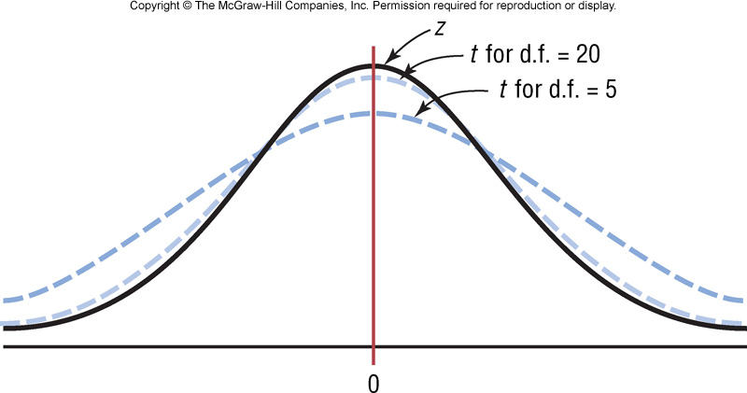
The t family of curves

Slide 52
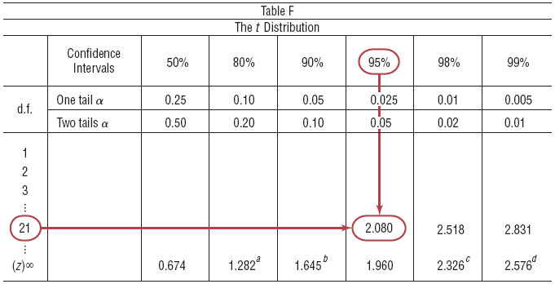
Example 7-5: Using Table F
Find the t_{α/2} value for a 95% confidence interval when the sample size is 22.
Degrees of freedom are d.f. = 21.

Slide 53
Exercises: Using Table F
Find the t_{α/2} value for a 99% confidence interval when n=18.
Find the t_{α/2} value for a 95% confidence interval when n=23.
Find the t_{α/2} value for a 90% confidence interval when n=10.
Find the t_{α/2} value for a 99% confidence interval when d.f.=18.

Slide 54
Formula for a Specific Confidence Interval for the Mean (When σ Is Unknown and n < 30, X~ND.)
Point Estimate ± (Critical Value)(Standard Error)
The degrees of freedom are n - 1.

Slide 55
Example: Sleeping Time
Ten randomly selected people were asked how long they slept at night. The mean time was 7.1 hours, and the standard deviation was 0.78 hour. Find the 95% confidence interval of the mean time. Assume the variable is normally distributed.
Since σ is unknown and s must replace it, the t distribution (Table F) must be used for the confidence interval. Hence, with 9 degrees of freedom, t_{α/2} (9)= 2.262.

Slide 56
Example: Sleeping Time
One can be 95% confident that the population mean is between 6.5 and 7.7 inches.

Slide 57
Example 7-7: Home Fires by Candles
The data represent a sample of the number of home fires started by candles for the past several years. Find the 99% confidence interval for the mean number of home fires started by candles each year.
5460 5900 6090 6310 7160 8440 9930
Step 1: Find the mean and standard deviation. The mean is = 7041.4 and standard deviation s = 1610.3.
Step 2: Find t_{α/2} in Table F. The confidence level is 99%, and the degrees of freedom d.f. = 6
t _{.005} = 3.707.

Slide 58
Example 7-7: Home Fires by Candles
Step 3: Substitute in the formula.
One can be 99% confident that the population mean number of home fires started by candles each year is between 4785.2 and 9297.6, based on a sample of home fires occurring over a period of 7 years.

Slide 59
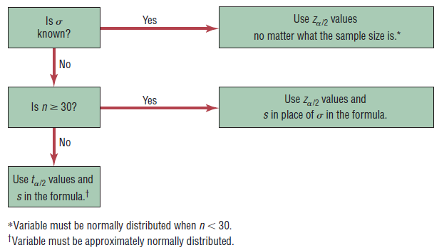
When to use the z or t distribution
Calculating the C.I. for a mean using a formula

Slide 60
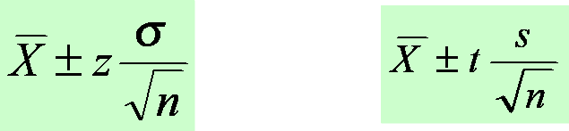
Confidence Interval Estimates for the Mean
Use Z-distribution
If the population standard deviation is known or the sample is greater than 30.
Use t-distribution
If the population standard deviation is unknown and the sample is less than 30.

Slide 61
Exercises
Section 7-1 (P.379)
1, 2, 5, 7
10, 11, 12, 14, 17, 24, 25
Section 7-2 (p.387)
2, 4, 6, 9, 11, 13, 14, 15, 20, 21

